Slide 1
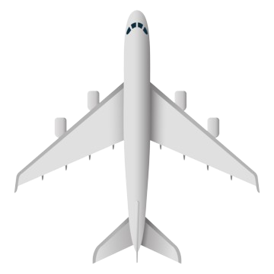
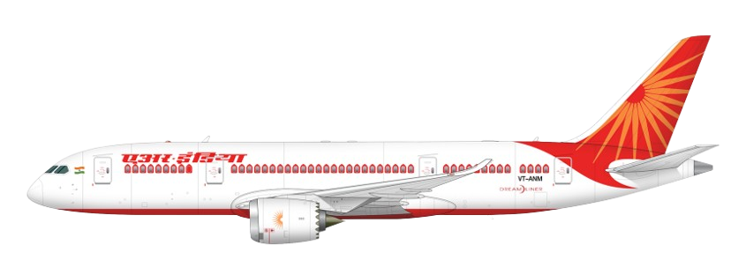
Welcome to the Presentation
Flight Price Prediction with Machine Learning and AI Chatbot

Slide 2

Presented By
Supervisor
Md. Raisul Islam
Reg: 18502003143
Md. Shamim Hossen
Lecture
Department of Computer
Science & Engineering
Tejgaon College, Dhaka.

Slide 3
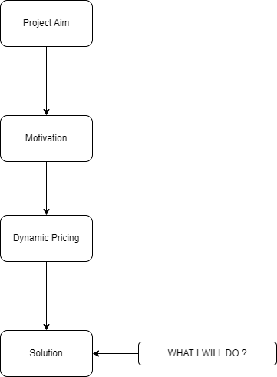
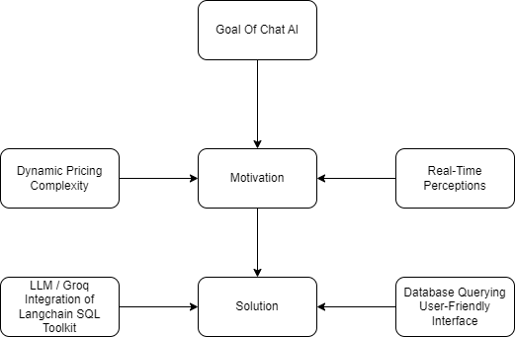
Flight Price Prediction VS AI ChatBot

Slide 4
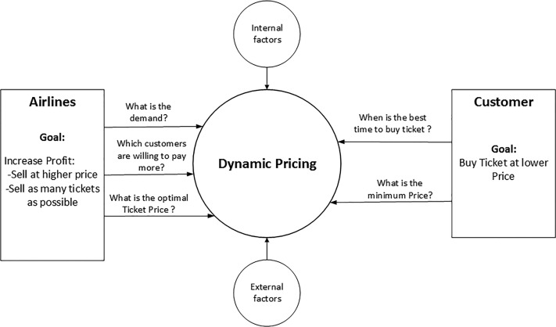
Dynamic Pricing

Slide 5
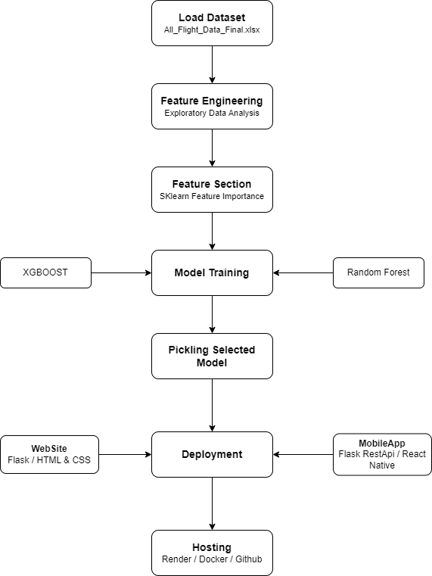
Project: Plan-of-action

Slide 6
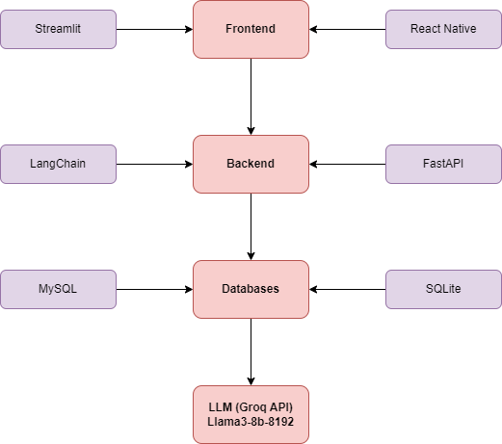
AI Chatbot: Plan-of-action

Slide 7
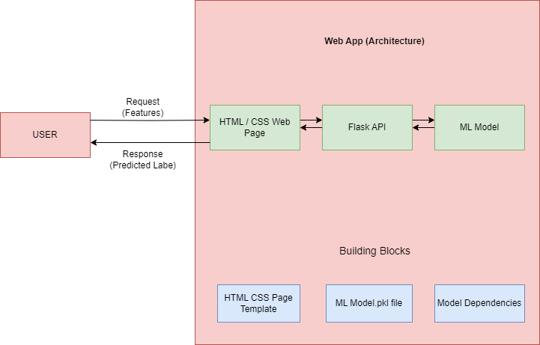
How the Web App Work

Slide 8

How the Mobile App Work

Slide 9
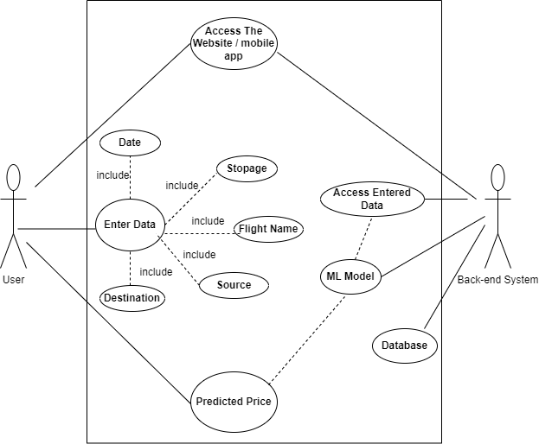
FlowChart Diagram - Flight Price Prediction

Slide 10
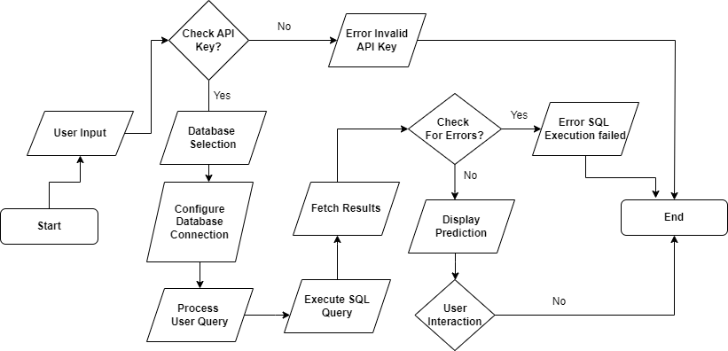
FlowChart Diagram - AI Chatbot

Slide 11
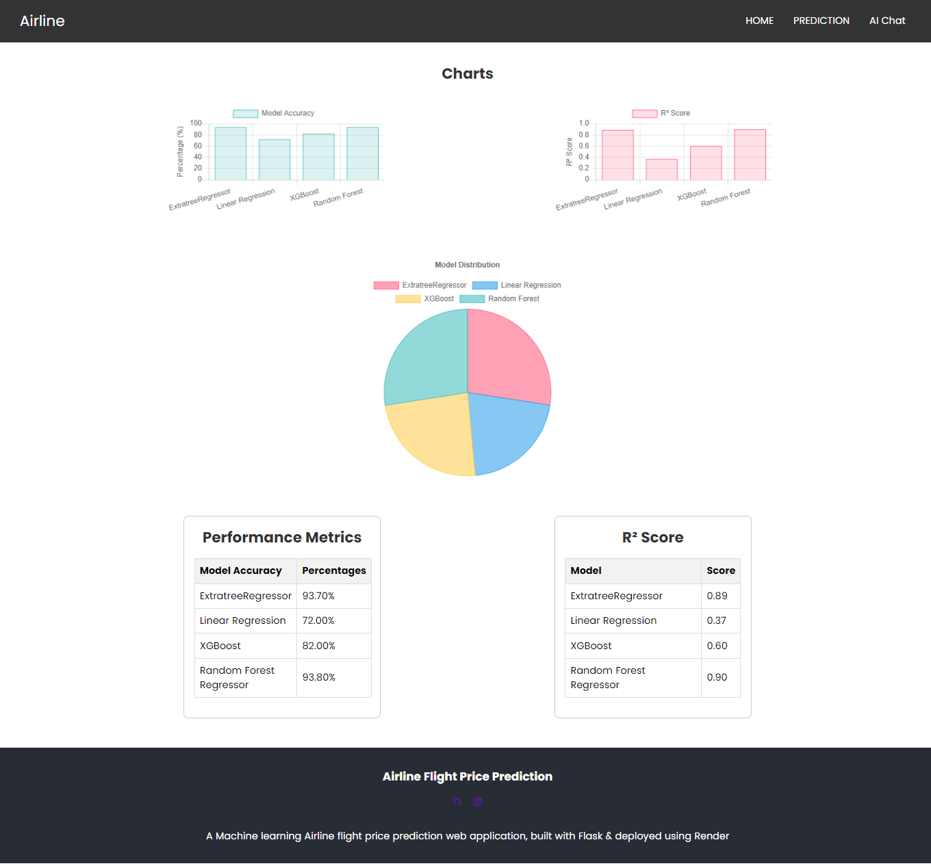

Slide 12
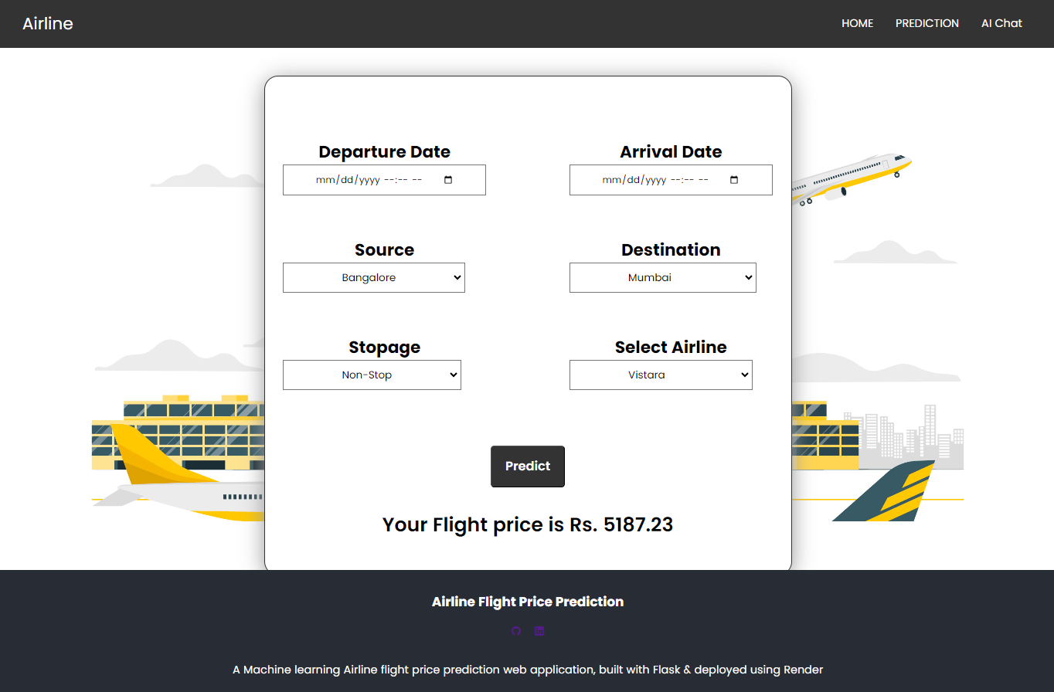

Slide 13
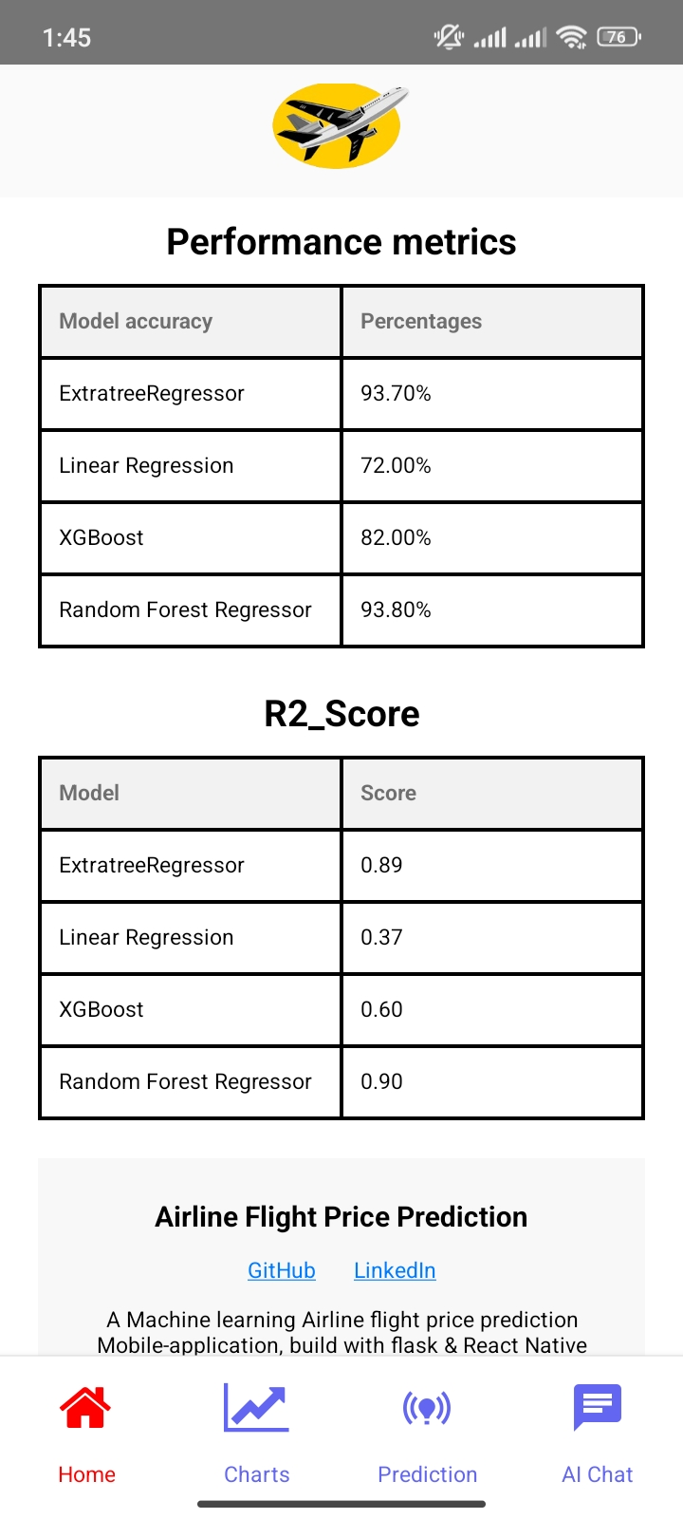
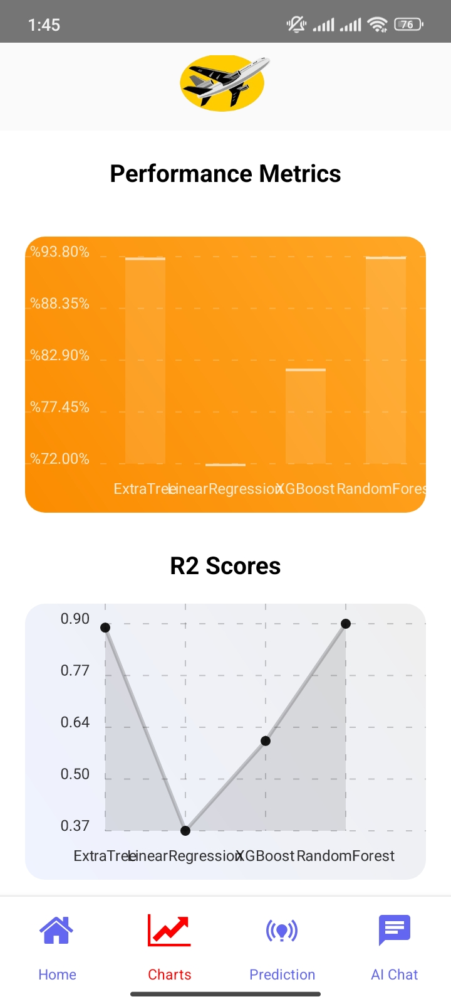
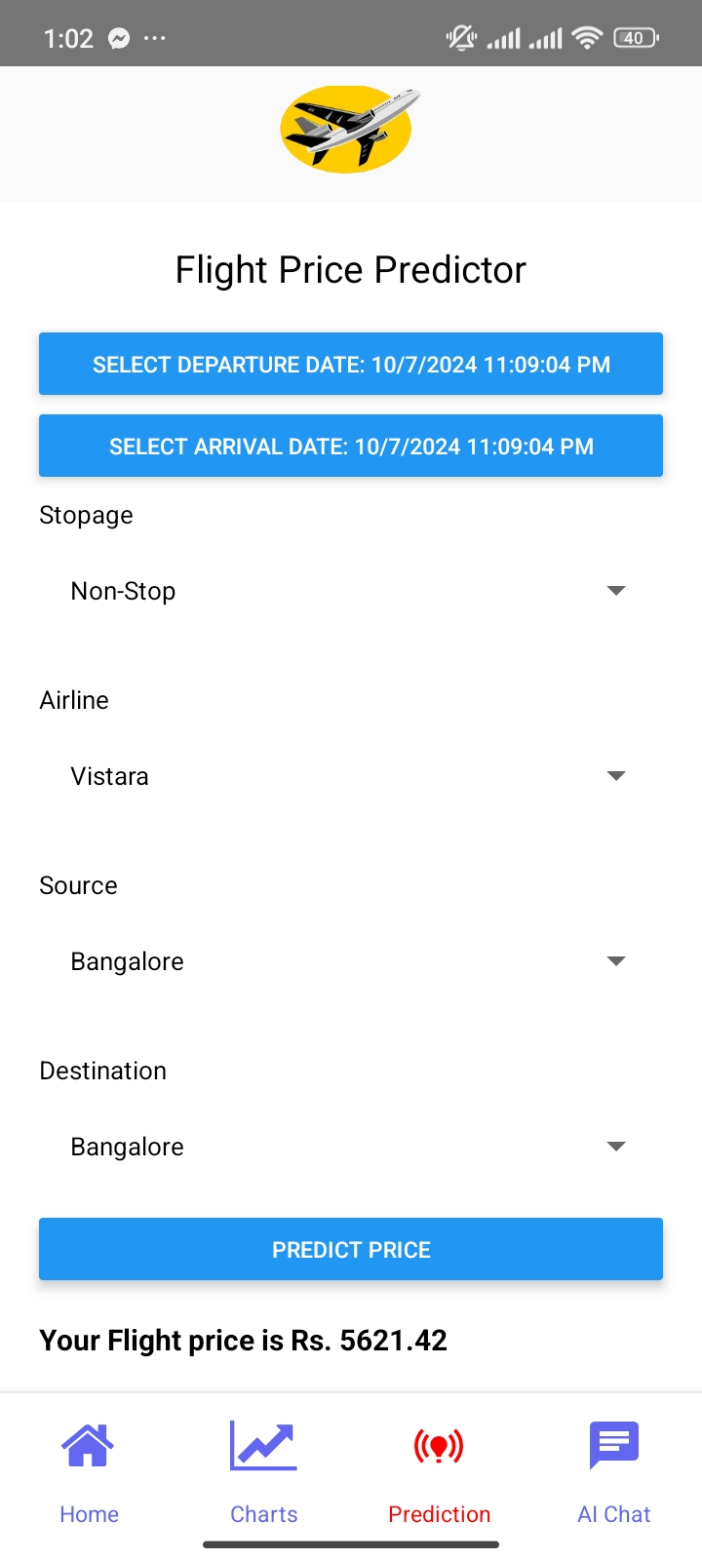

Slide 14
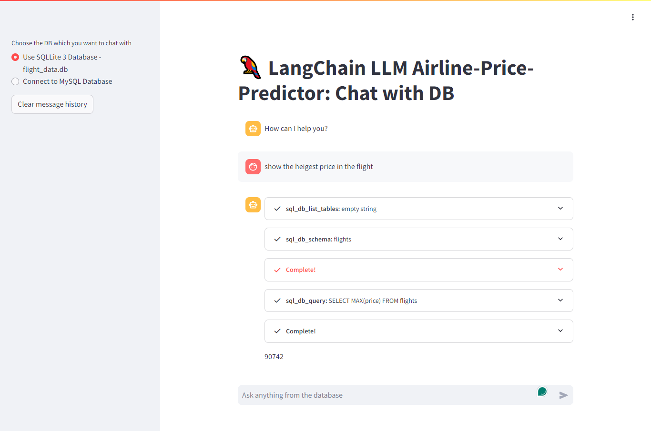

Slide 15
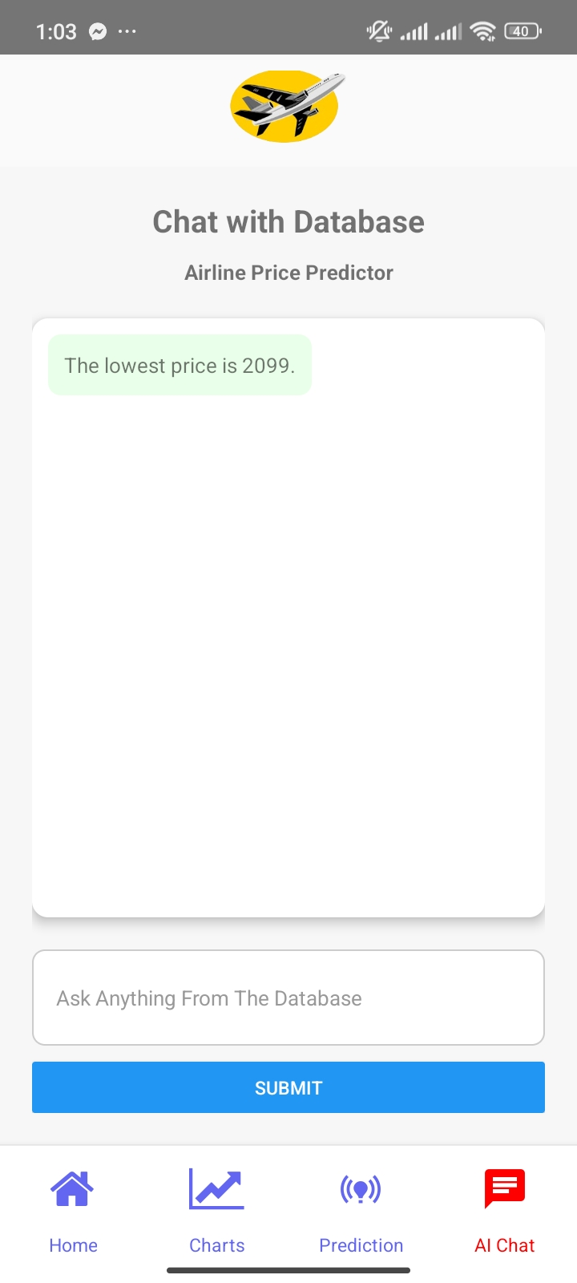

Slide 16
Thank you very much for giving me a soundless patient hearing

